Slide 1

Anti-Money Laundering Detection Using Machine Learning

Slide 2

Project Leadership
Sharat Manikonda
Director at Innodatatics and Sponsor
linkedin.com/in/sharat-chandra
Notes:
This project contains various account transactions which leads money laundry

Slide 3

Team Member and Project Creator
Name: Suraj Y Veggalam
Batch: Project team 95
https://www.linkedin.com/in/suraj-veggalam-080764229/

Slide 4

Contents
Project Overview and Scope
Project Goals
Project Goals
Technical Stacks
Project Architecture
Data Collection and Understanding
Data Information
Data Dictionary
System Requirements
Exploratory Data Analysis [EDA]
Visualization and Model Building
Model Accuracy
Model Deployment – Strategy
Screenshot of output
Challenges
Future Scopes
Notes:
Change

Slide 5
Project Overview and Scope
The Overview and Scope of this project, is to build a model to predict and show us the false traction or fraud transaction which is Money Laundering and deploy so that it can be user for further processes.
Machine learning for AML helps organizations recognize suspicious behaviors and prioritize their responses based on the level of perceived risk. As the machine learning model detects, flags, and prioritizes cases, AML analysts step in to review those alerts manually to make decisions regarding investigations, file Suspicious Activity Reports (SARs) to remain compliant, and assist law enforcement teams to prosecute economic criminals.

Slide 6
Business Problem
Detection of the fraud transaction .
Money Laundering prediction.
Model which can be deployed for detection of transaction.
Reducing the number of false positives.
More accurately identifying money laundering.
Criminals constantly find new ways to launder money.
Making the financial institutions to detect and prevent these activities
Now a days businesses that provide services to clients virtually and never actually meet them are at higher risk of being used for money laundering and terrorist financing.
This include remote banking and payment services, as well as currency exchanges and in real estate transactions where the buyer is not present but the done transactions is done.

Slide 7
OBJECTIVE AND CONSTRAINTS
Objective
Constraints
Accurately identifying money laundering.
Reducing the number of fraud transactions.
The purpose of the AML rules is to help detect and report suspicious activity including the terrorist funding.
Optimize Storage Space
Surface unknown threats by finding new connections in the data.
Minimize Logistical Cost
Reduce runtime (Time Complexity)
Accuracy of the Prediction
Deployment cost
Insufficient Datasets or types of datasets.

Slide 8
CRISP-ML(Q) Methodology
Business understanding
Data understanding
Data preparation
Modeling
Evaluation
Deployment
Monitoring and Maintenance

Slide 9
Technical Stacks
There are many ways to program and deploy models but here we have used:
Spyder Notebook
Microsoft Excel
Spyder from Anaconda ( Local System )
Deployment using Streamlit
Microsoft Powerpoint - Presentation
Google Drive – Sharing Resources
Google Meet for meeting and Group discussion

Slide 10
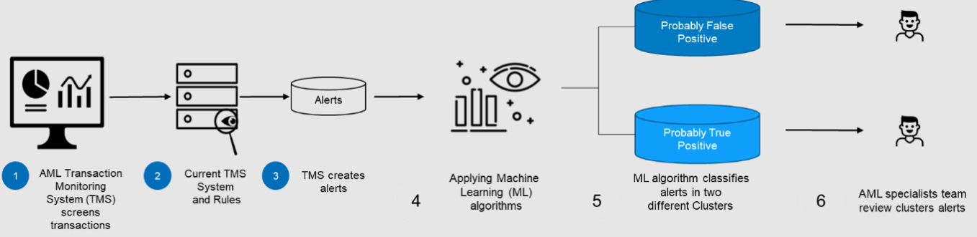
Project Architecture

Slide 11
Data Collection and Understanding
type - Type of transaction
amount - Amount in the transaction
nameOrig - Name code at the source of transaction
oldbalanceOrg - Old balance (source)
newbalanceOrig - New balance (Source)
nameDest - Name at the destination or at the end
oldbalanceDest - Old destination balance amount
newbalanceDest - New destination balance amount
isFraud - Fraud marked for supervised ML.
isFlaggedFraud - Fraud Flagged,important(definite) Fraud.

Slide 12
Data Information
Data was being provided by the 360DigiTMG team mentors.
This data consist of 100000 entries, 0 to 99999.
The shape of this data is (100000, 12) or 10000 rows and 12 columns of data in which one column is Unnamed column which will be dropped.
This data is mostly used for Supervised machine learning because the data consist of already recorded fraud and flagged fraud data along with all the transaction amount and its types from source and destination.
Also tried other data sets available on Kaggle .

Slide 13
Data Dictionary
CASH-IN, CASH-OUT, DEBIT, PAYMENT and TRANSFER.
amount - amount of the transaction in local currency.
nameOrig - customer who started the transaction
oldbalanceOrg - initial balance before the transaction.
newbalanceOrig - new balance after the transaction
nameDest - customer who is the recipient of the transaction
oldbalanceDest - initial balance recipient before the transaction. Note that there is not information for customers that start with M (Merchants).
newbalanceDest - new balance recipient after the transaction. Note that there is not information for customers that start with M (Merchants).
isFraud - This is the transactions made by the fraudulent agents inside the simulation. In this specific dataset the fraudulent behavior of the agents aims to profit by taking control or customers accounts and try to empty the funds by transferring to another account and then cashing out of the system.
isFlaggedFraud - The business model aims to control massive transfers from one account to another and flags illegal attempts. An illegal attempt in this dataset is an attempt to transfer more than 200.000 in a single transaction.

Slide 14
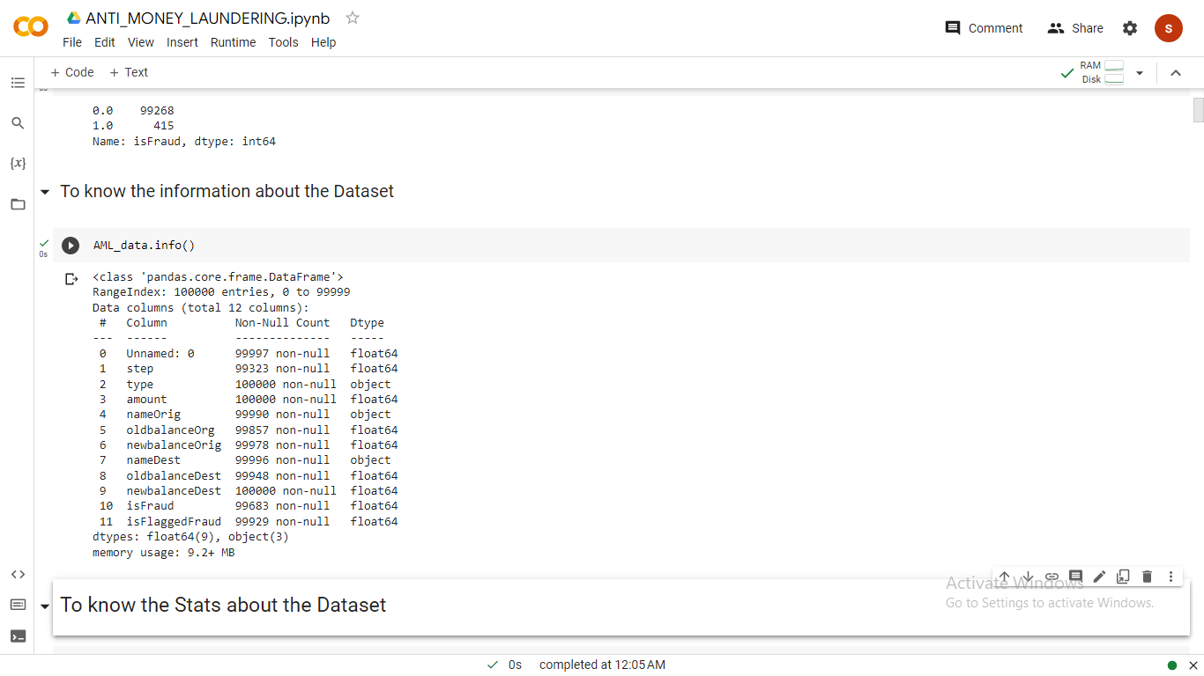
Data Dictionary

Slide 15
System Requirements
A Standard System requirement for Data Science:
1. RAM (4 GB Minimum)
2. Hard Disk 512 GB
3. SSD (120 GB)
Graphics Card (Additional, If Possible but not Mandatory)
2 Monitors will be helpful ( optional )
Good Processor i3 .

Slide 16
Exploratory Data Analysis [EDA]
Exploratory Data Analysis was performed on every Dataset Combined , some of the methods are:
Measure of Central Tendency
Mean, Median, Mode
2. Measure of Dispersion/Spread
Variance, Standard deviation
3. Skewness
4. Kurtosis
Notes:
EDA is used for seeing what the data can tell us before the modeling task.
Change

Slide 17
EDA Description
EDA gave us a lot of information about the growth of the plant along with visualization of different plots.
Measure of Central Tendency
Mean ( The average value.)
Median( The middle most value of the dataset.)
Mode ( The most Frequent occurring Value.)
2. Measure of Dispersion/Spread
Variance( this gives us information of how spread out the data is if this is 0 then it is not spread or same values in entire dataset.
Standard deviation is the Square root of variance.
Skewness the direction of spread is measured with Skewness.
Left Skewed or Right skewed or symmetric.
Kurtosis the Extent of spread is measured with kurtosis.
Platykurtic
Leptokurtic
Mesokurtic

Slide 18
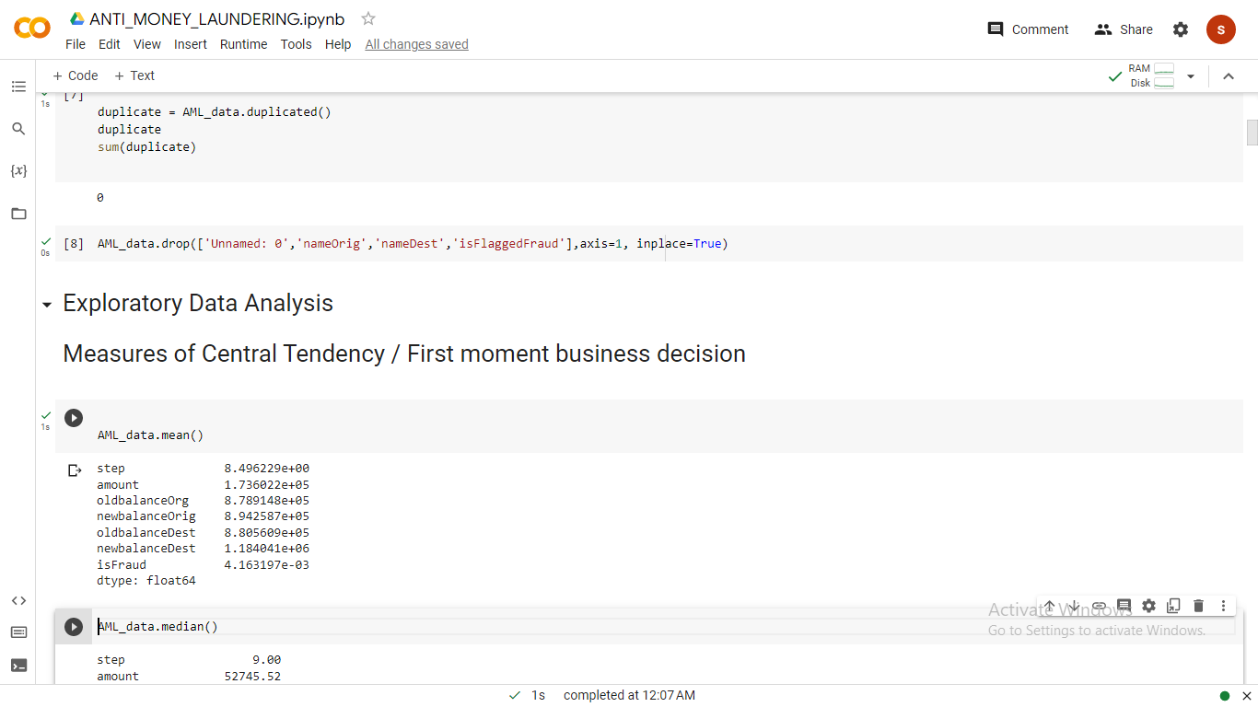
EDA Description

Slide 19
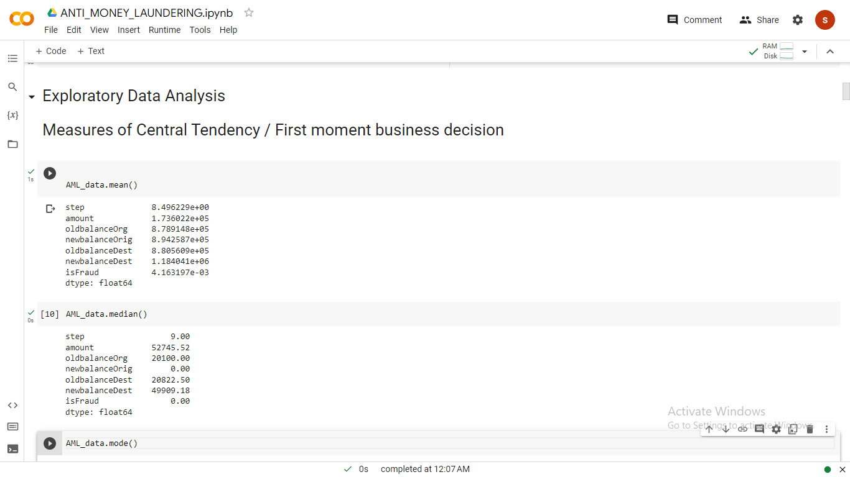

Slide 20
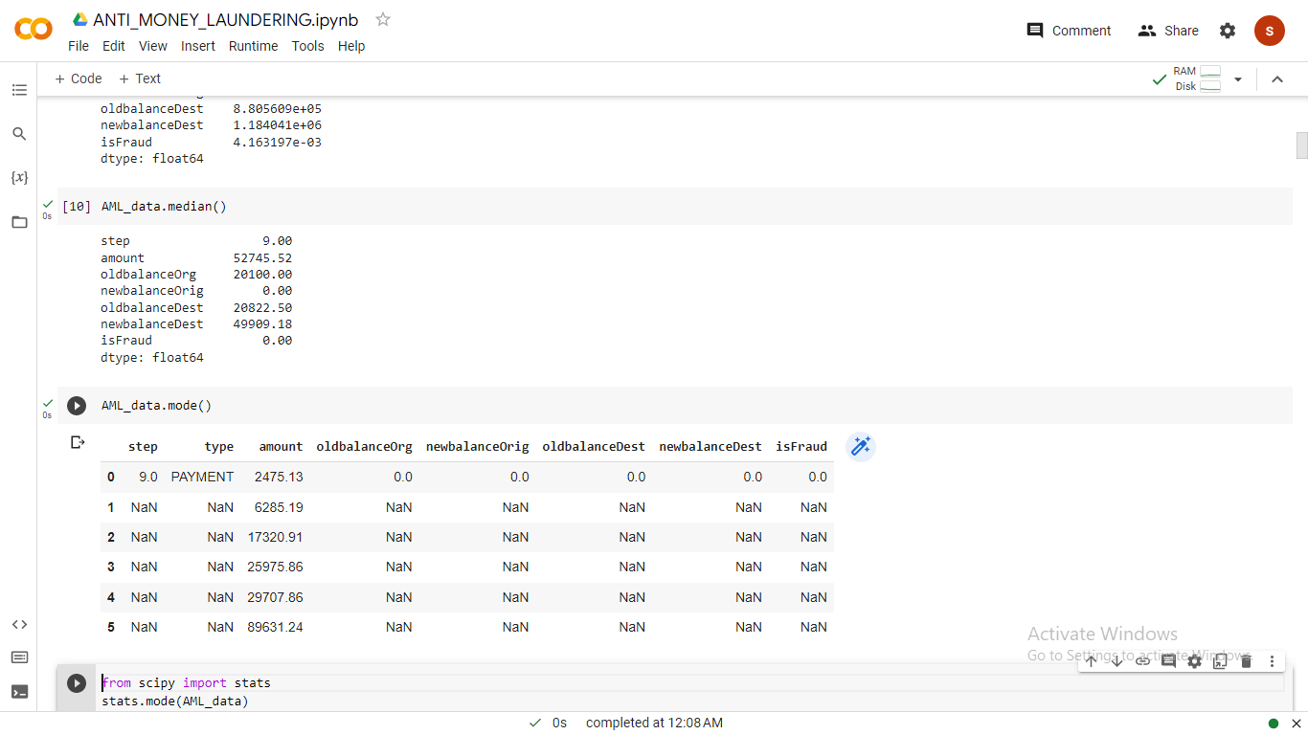

Slide 21
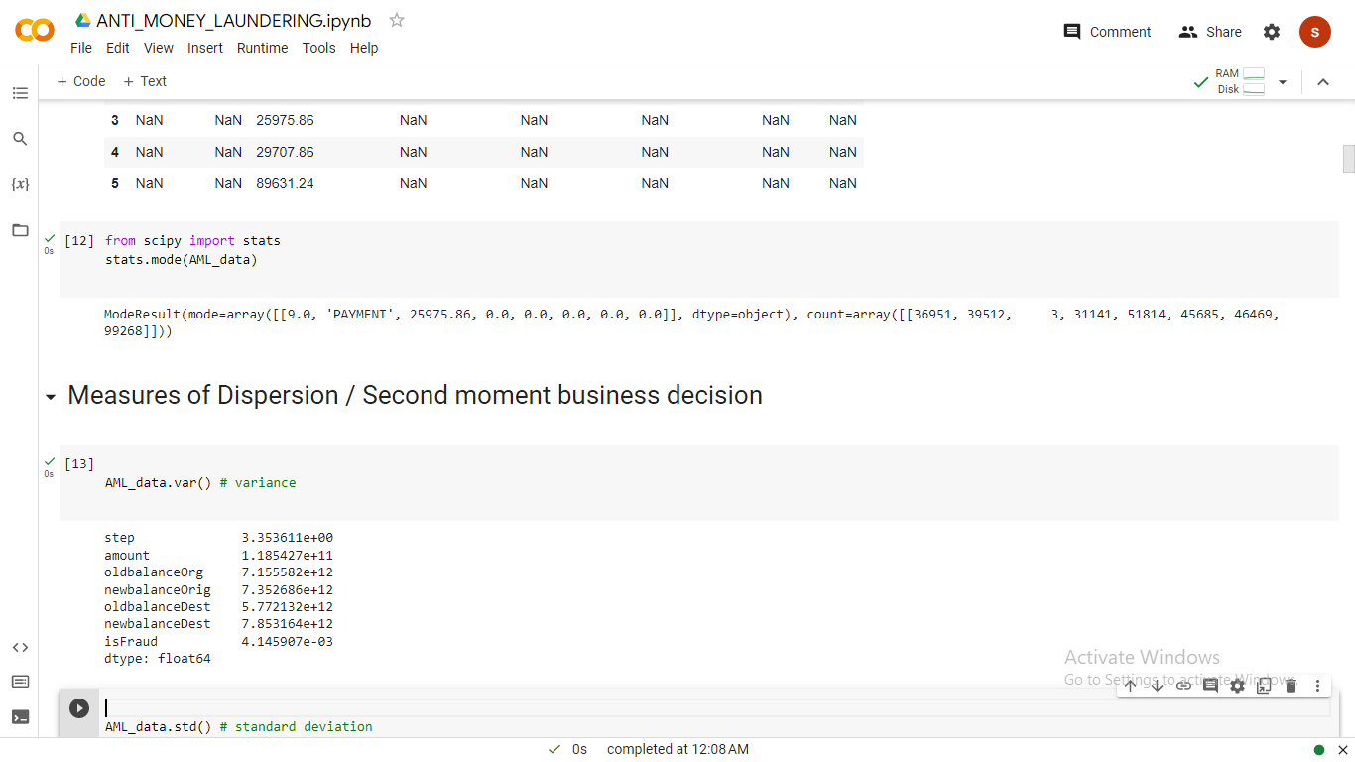

Slide 22
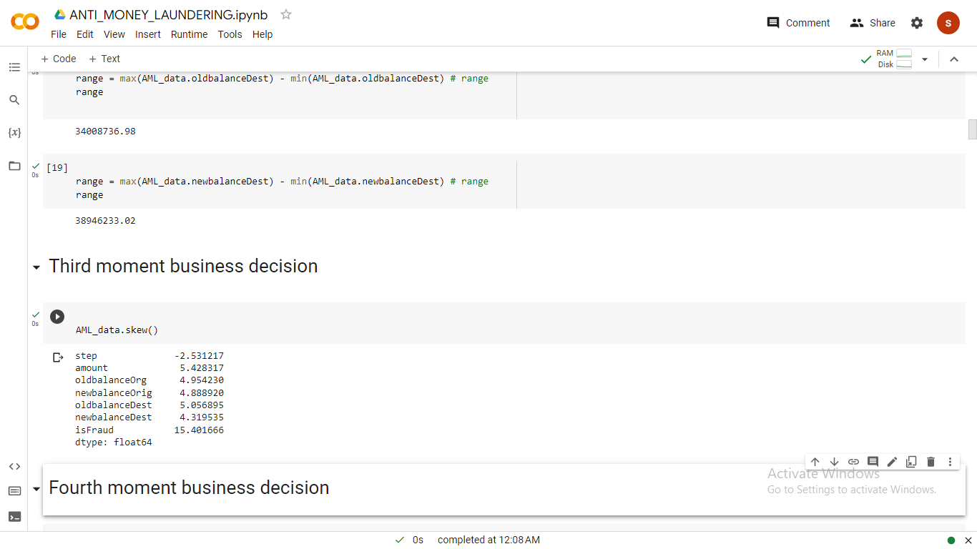

Slide 23
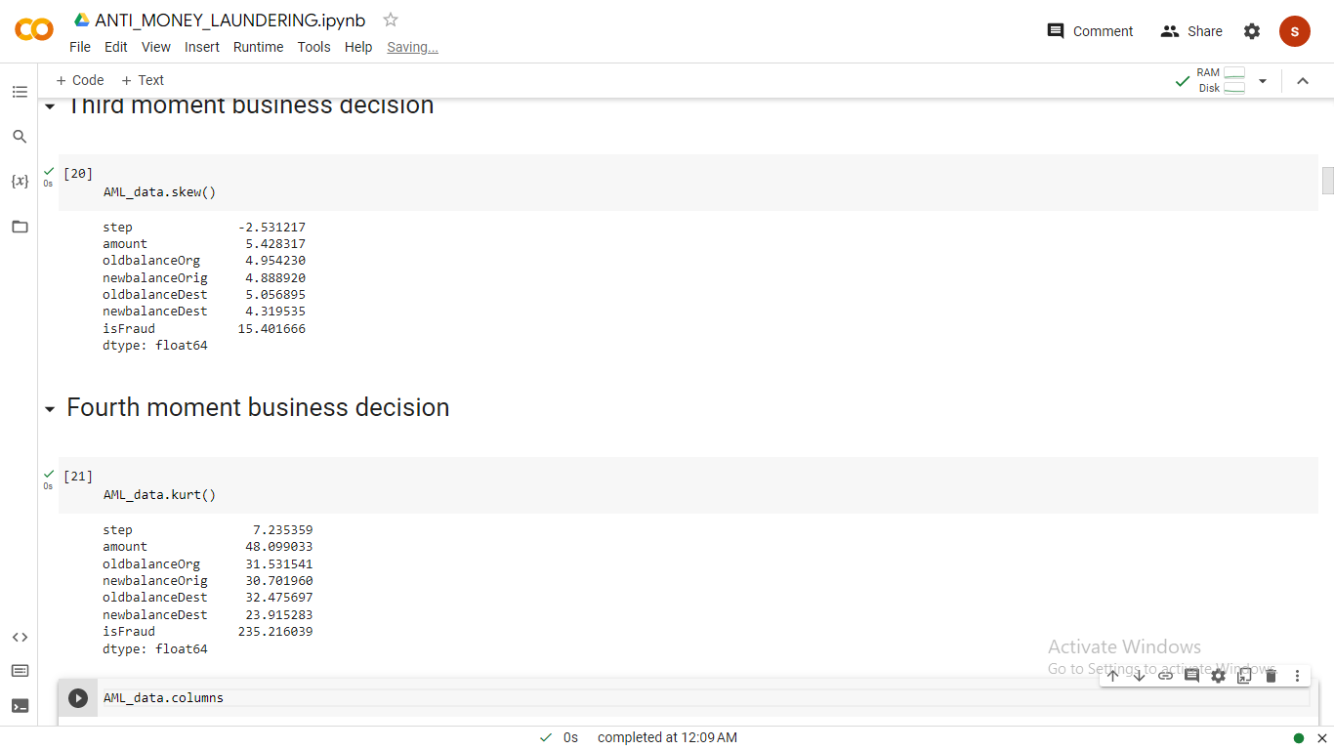

Slide 24
Missing Values Observation
We found lot of missing values in the transaction data and fraud and we used missing value imputation in which we used Mean imputation which fills all the missing values with the mean of the data so that it balances the data and most of them time is approximately same value.
.isnull() Was used in the program to find the missing values.
We used fillna function to replace values of median and mode to missing data in particular columns.
amldata1["step"].fillna(amldata1["step"].median(), inplace = True)
### nameOrig
amldata1["nameOrig"].fillna(amldata1["nameOrig"].mode(), inplace = True)
###NewbalanceOrig
value3=amldata1['newbalanceOrig']+amldata1["amount"]
amldata1['oldbalanceOrg'].fillna(value3, inplace = True)
### OldbalanceOrg
value2 = amldata1['oldbalanceOrg'] - amldata1["amount"]
amldata1['newbalanceOrig'].fillna(value2, inplace = True)

Slide 25
Missing Values Observation
##nameDest
amldata1['nameDest'].fillna(amldata1['nameDest'].mode(), inplace = True)
##oldbalanceDest
amldata1['oldbalanceDest'].fillna(amldata1['oldbalanceDest'].mean(), inplace = True)
##isFraud
amldata1['isFraud'].fillna(amldata1['isFraud'].mode()[0],inplace=True)
##isFraud
amldata1['isFlaggedFraud'].fillna(amldata1['isFlaggedFraud'].mode()[0],inplace=True)
amldata1.isna().sum()

Slide 26
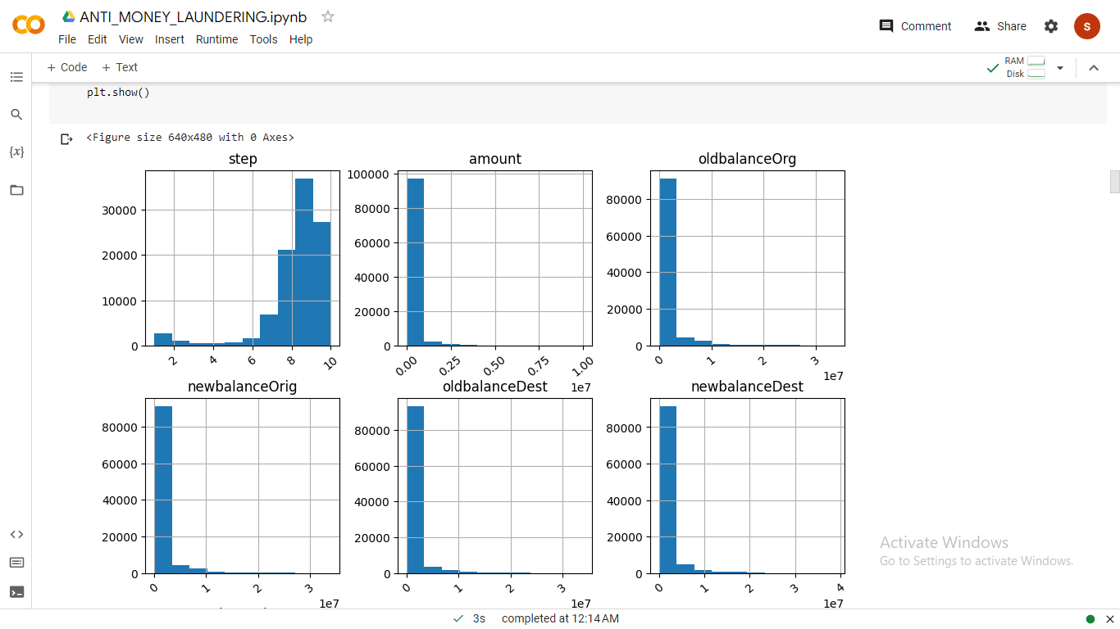
Data Visualization
Histogram Graph o the Data
New Balance Dest
Old Balance Dest
Notes:
Keep observations

Slide 27
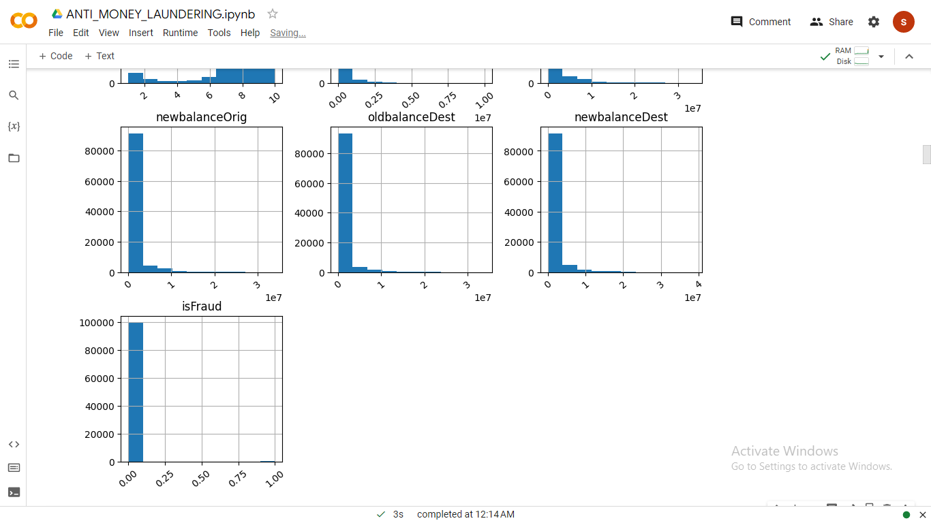
Data Visualization
Histogram
Notes:
Add graphical

Slide 28
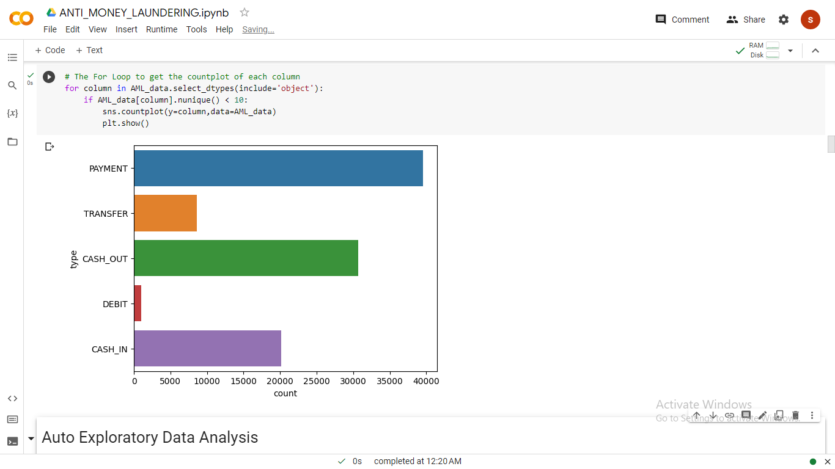
Data Visualization
Count plot For Type column
Notes:
Piee

Slide 29
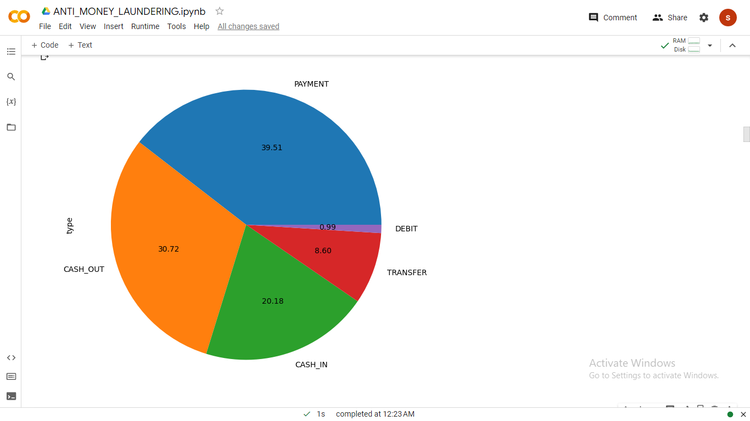
Data Visualization
Pie Chart For Type column
Notes:
Piee

Slide 30
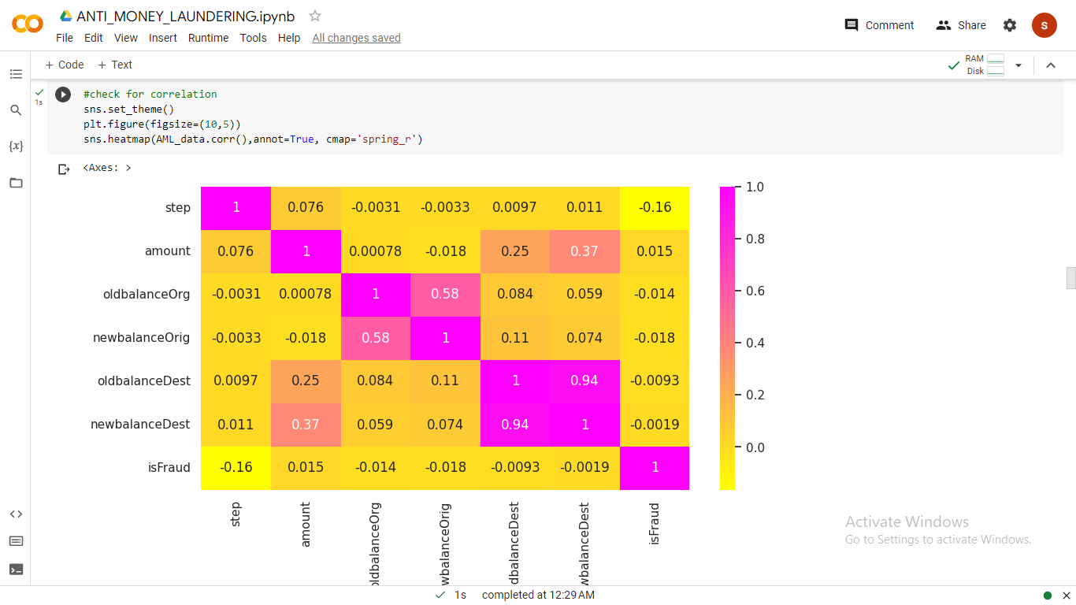
Data Visualization
Heat Map For all columns
Notes:
Piee

Slide 31
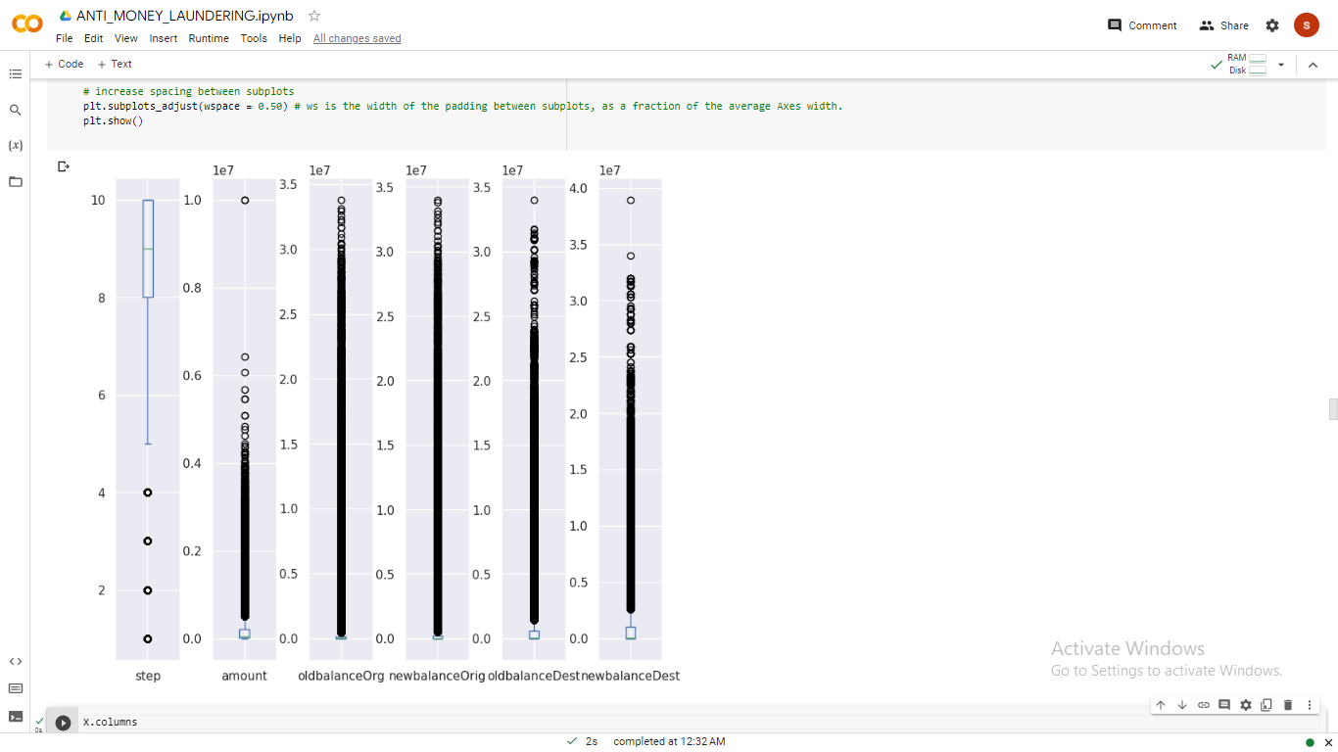
Data Visualization
Boxplot for the numerical columns
Notes:
Piee

Slide 32
Model Building
We have used both supervised and unsupervised models
1. In Supervised model.
Here we have used Classification and Regression models which gives output in between 0 and 1.
I have done a own code for multiple Classification algorithm with the precision and F1 scores comparison.
In classification we get wither 0 or 1 ( Discrete numbers )
In Regression we get values in between 0 and 1. ( Continuous numbers )
In fraud Prediction we have used Classification Algorithm for prediction of fraud of the transaction amount.
In Flagged fraud Prediction we have used Classification Algorithm for prediction of fraud of the transaction amount..
Notes:
classification is the task of predicting a discrete class label. Regression is the task of predicting a continuous quantity.
What is classification techniques in machine learning?
The Classification algorithm is a Supervised Learning technique that is used to identify the category of new observations on the basis of training data. In Classification, a program learns from the given dataset or observations and then classifies new observation into several classes or groups.
What is regression techniques in machine learning?
Regression is a technique for investigating the relationship between independent variables or features and a dependent variable or outcome. It's used as a method for predictive modeling in machine learning, in which an algorithm is used to predict continuous outcomes.

Slide 33
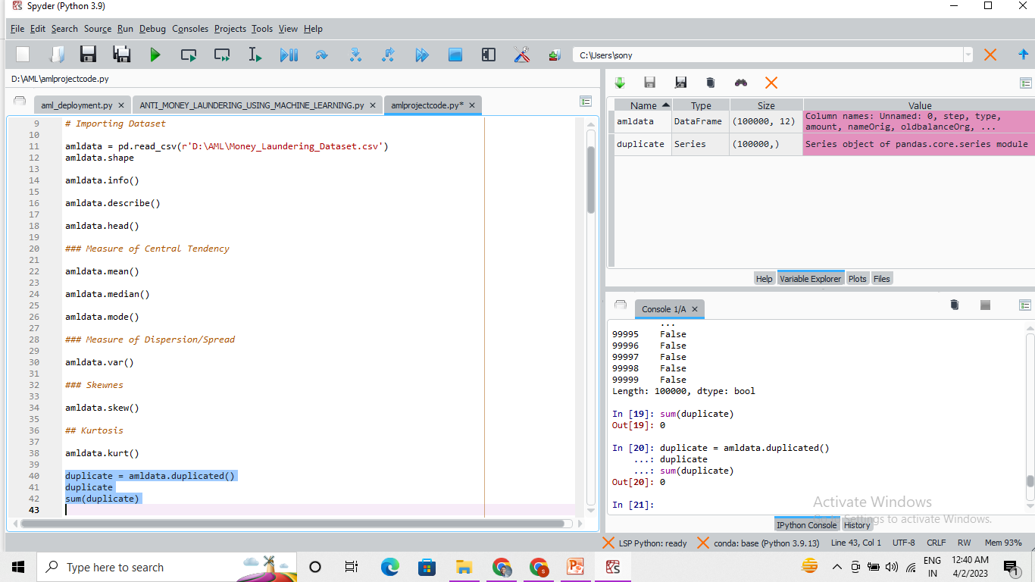
Model Building –
Notes:
What is the role of regression in ML
Is regression supervised or unsupervised?

Slide 34
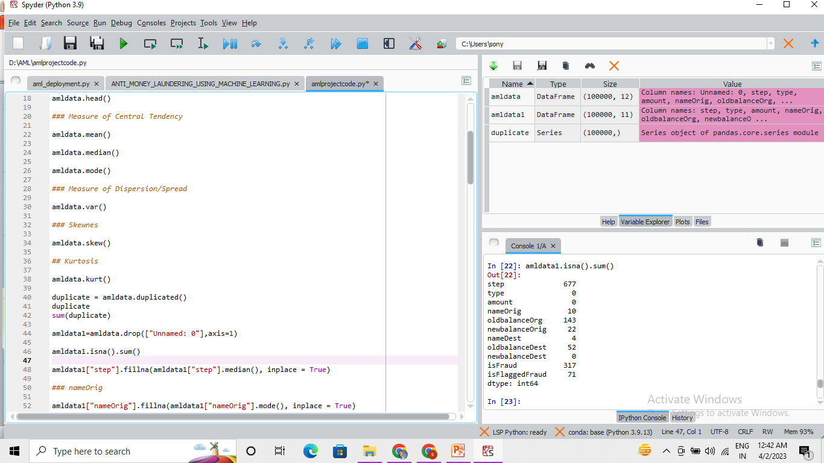
Model Building –
Notes:
What is the role of regression in ML
Is regression supervised or unsupervised?

Slide 35
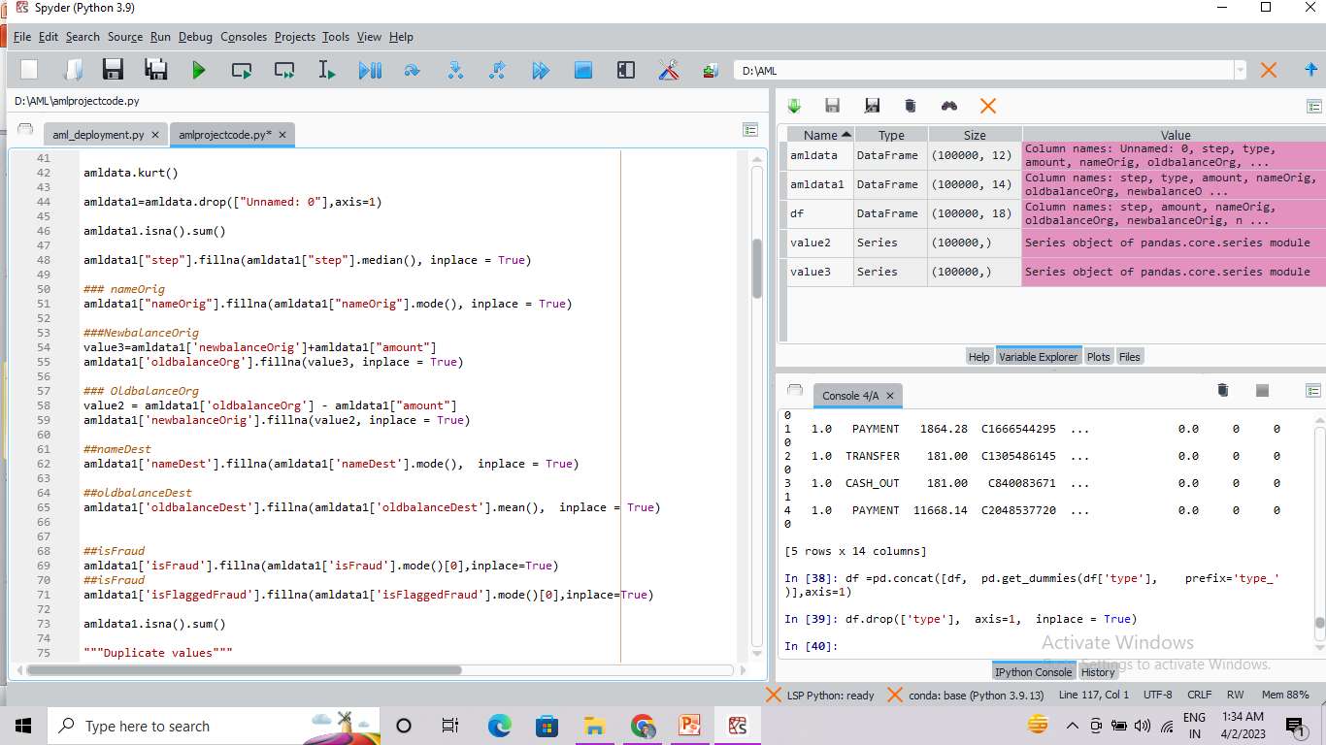
Model Building –

Slide 36
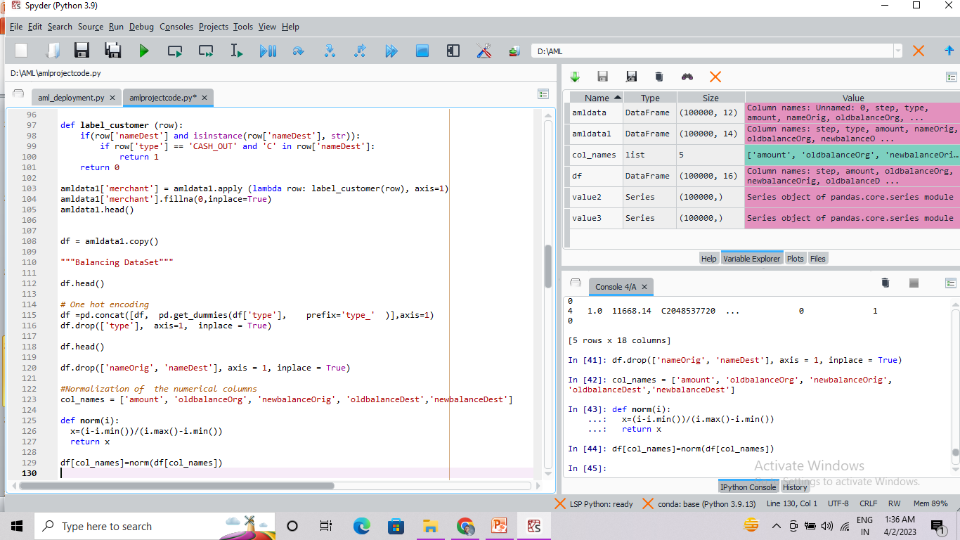
Model Building –

Slide 37
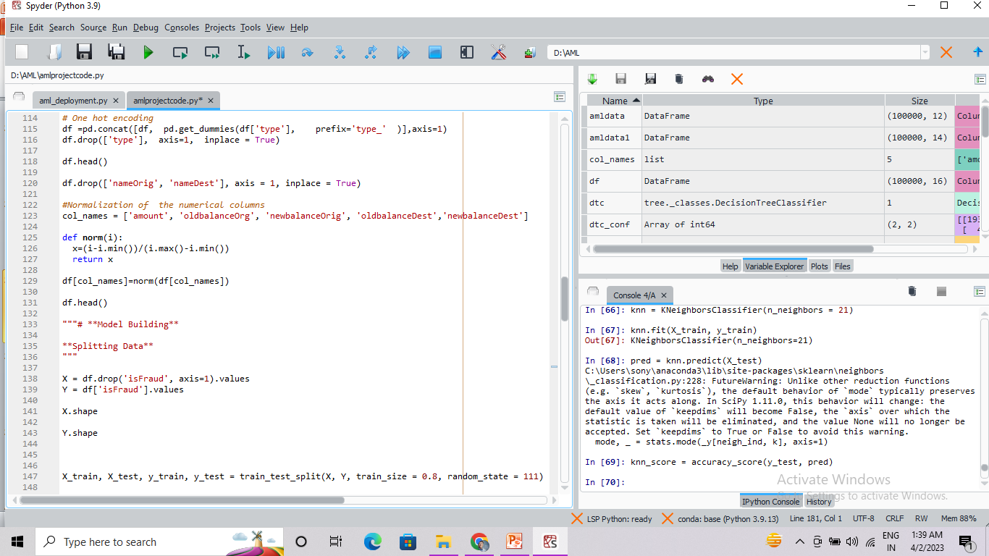
Model Building –

Slide 38
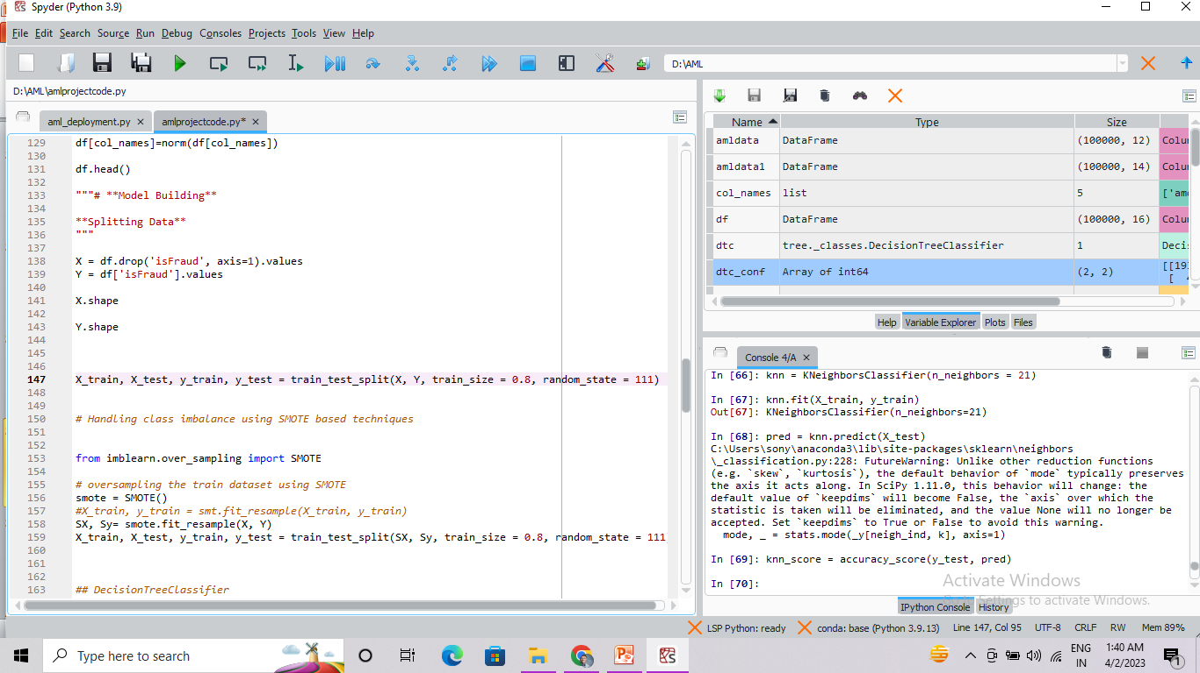
Model Building –

Slide 39
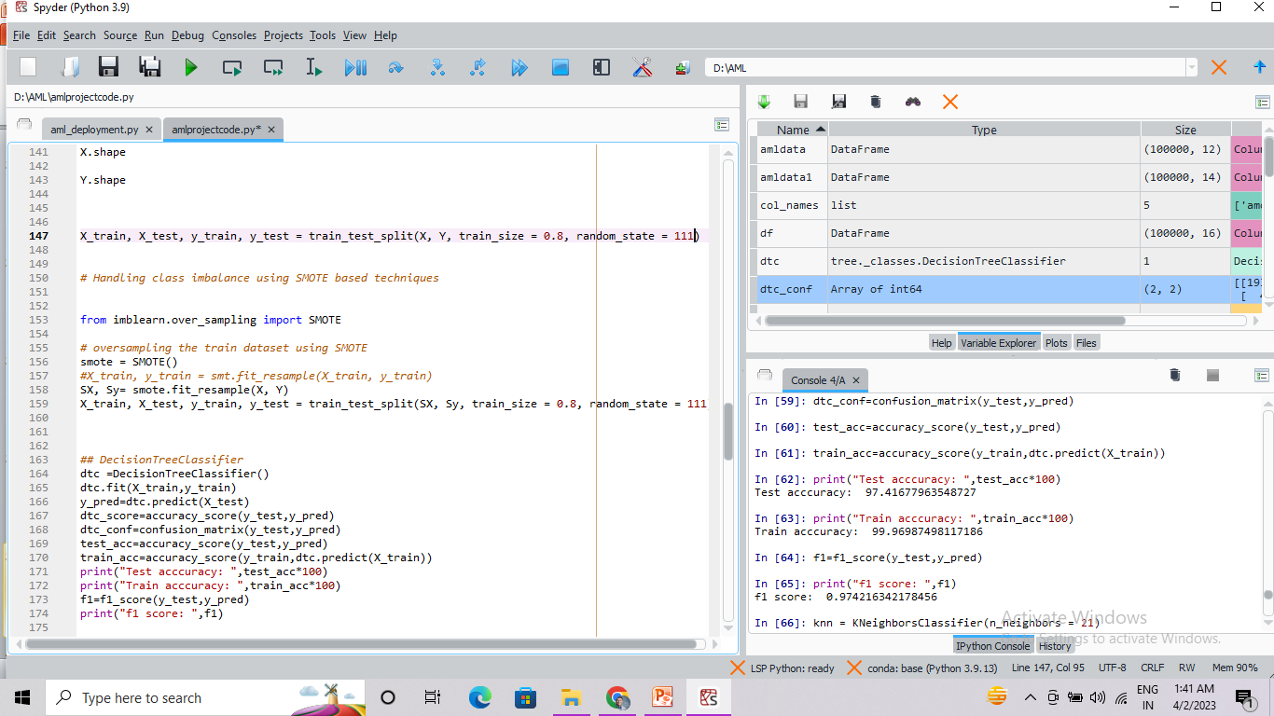
Model Accuracy Comparison

Slide 40
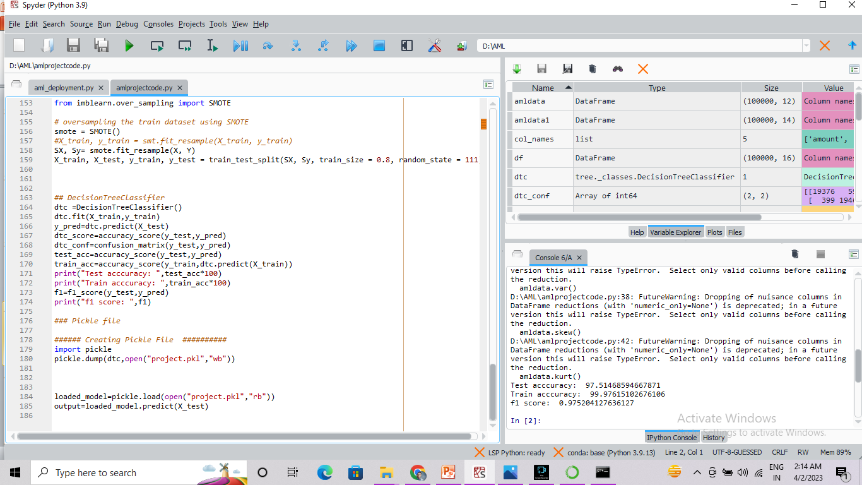
Best Model –
Notes:
Why Random Forest Regression is good?
A Random Forest Regression model is powerful and accurate. It usually performs great on many problems, including features with non-linear relationships
How is XGBoost different from random forest?
One of the most important differences between XG Boost and Random forest is that the XGBoost always gives more importance to functional space when reducing the cost of a model while Random Forest tries to give more preferences to hyperparameters to optimize the model..
n_estimators — the number of decision trees you will be running in the model

Slide 41
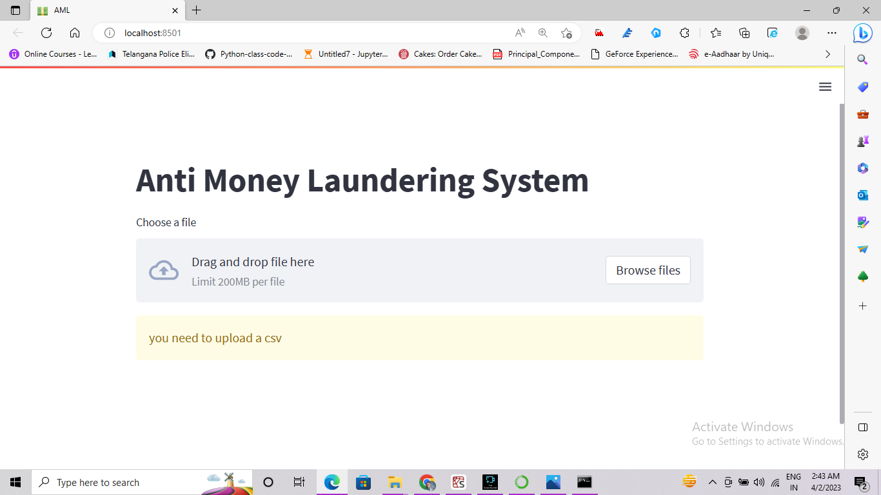
Model Deployment - Strategy
We Deploy the model in Local system using Streamlit.

Slide 42
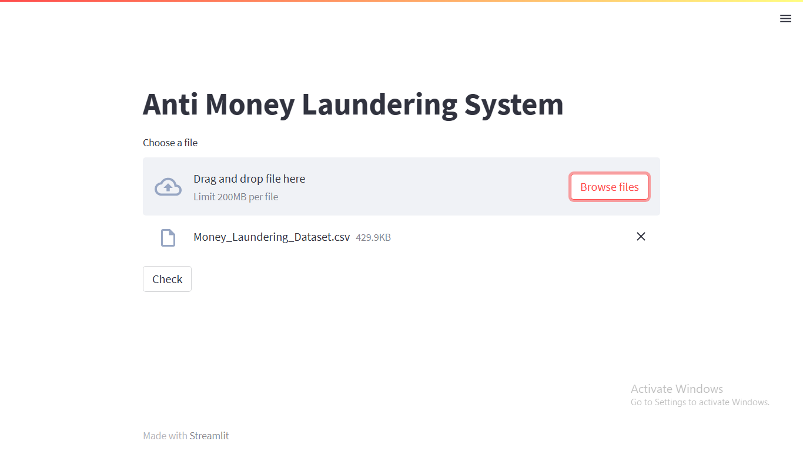
Model Deployment - Strategy
We Deploy the model in Local system using streamlit

Slide 43
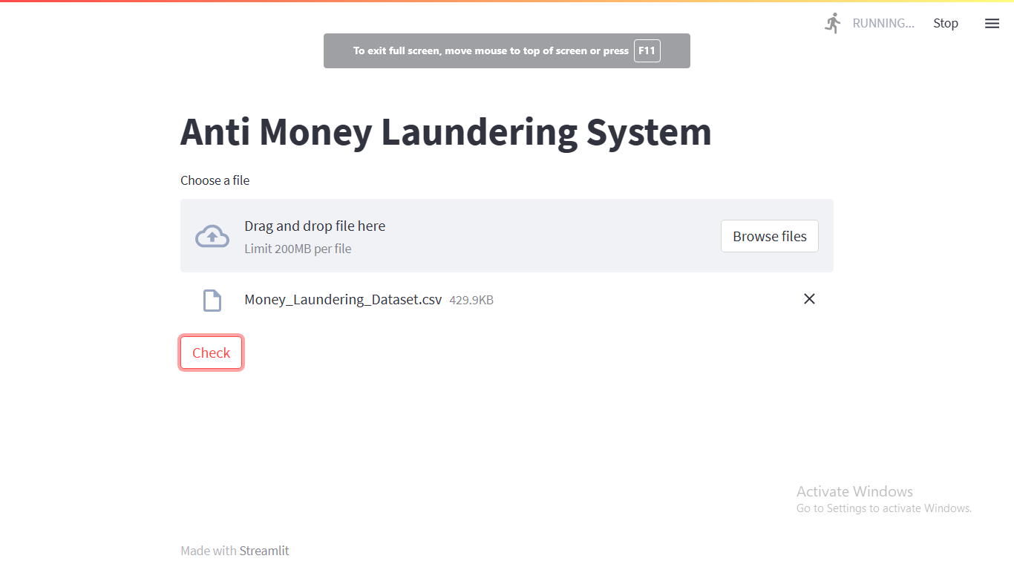
Model Deployment - Strategy
We Deploy the model in Local system using streamlit

Slide 44
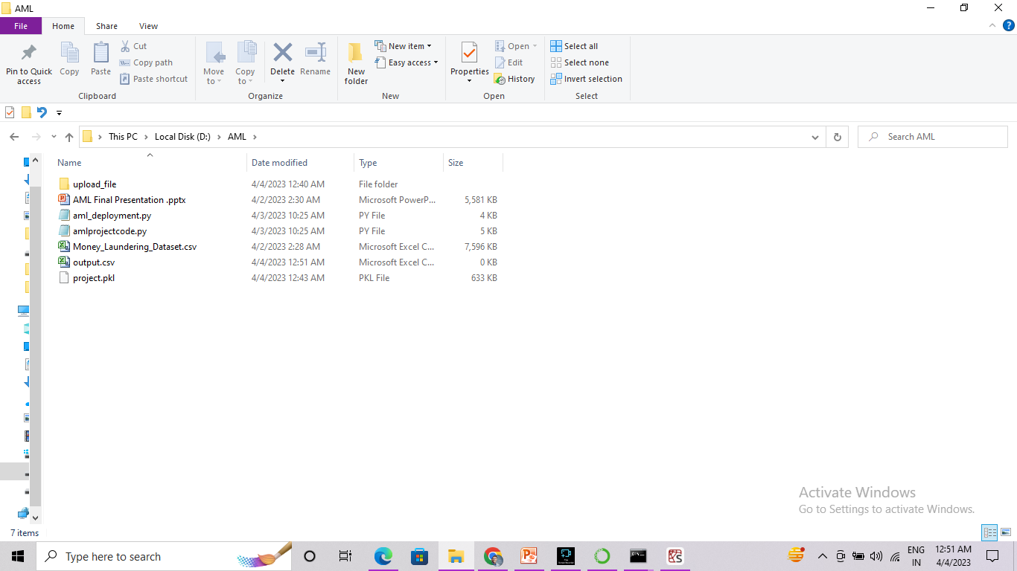
Model Deployment - Strategy
We Deploy the model in Local system using streamlit

Slide 45
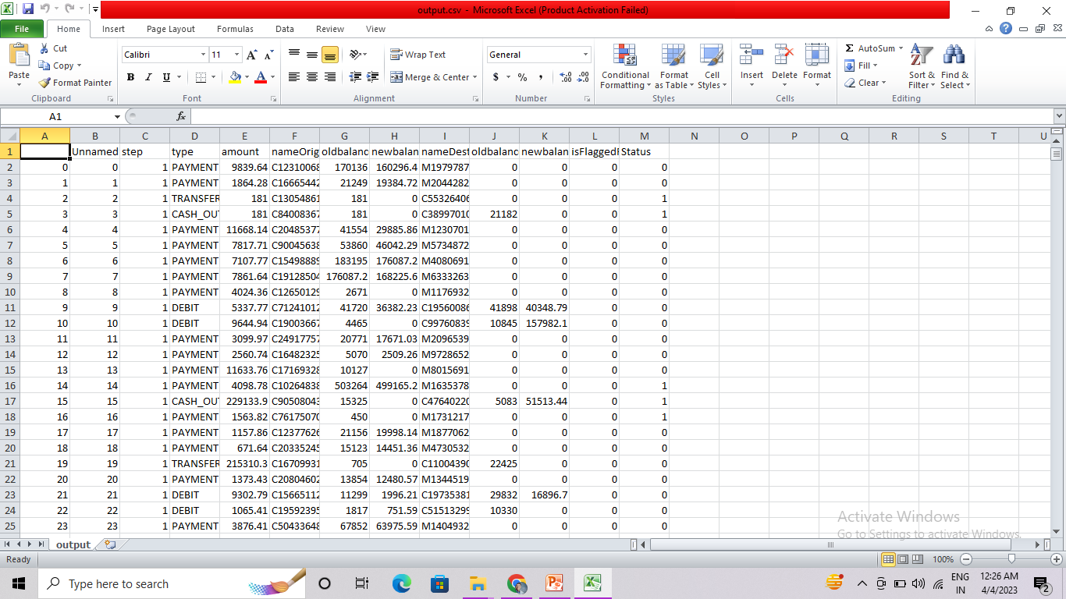
Screenshot of output

Slide 46
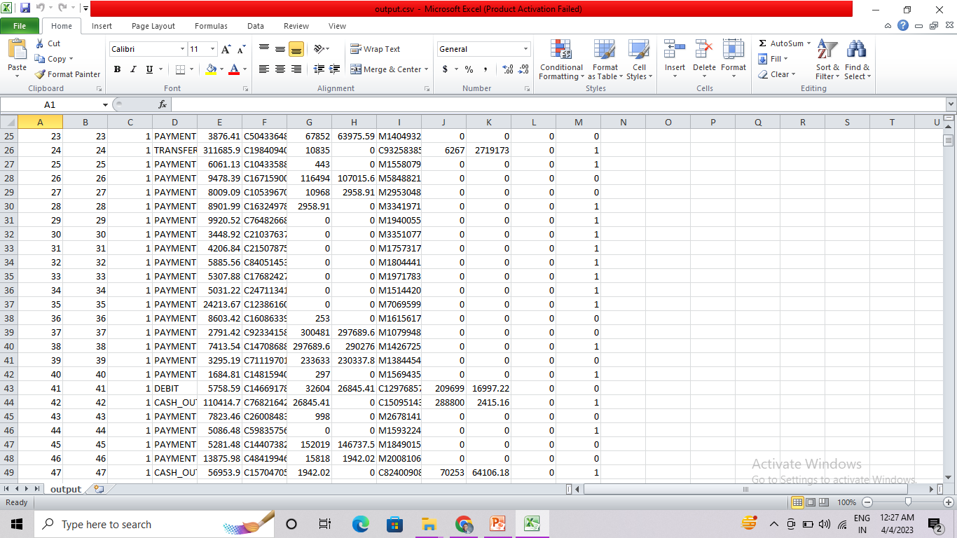
Screenshot of output

Slide 47
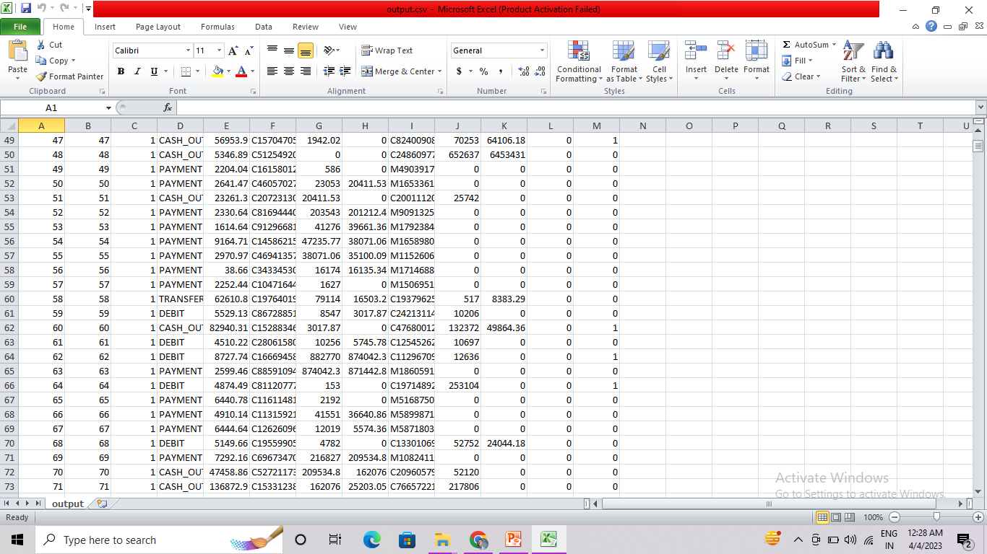
Video of output

Slide 48
Challenges
Some of the major challenges are :
Improper dataset or very lengthy and missing lots of values.
Wrong recordings of Data
More data required from individual farms
Need more IOT tools and accuracy measures.
Streamlit for deployment but it is very tricky .

Slide 49
Future Scopes
Recent enhancements in machine learning are helping banks to improve their anti-money laundering (AML) programs significantly. Regulators are supporting these efforts and working with banks to test new approaches.
Transaction is everywhere in the world but only Machine Learning can adopt to new ways and make significant prediction with accuracy because it keeps on learning new things as it updates continuously.
Already 90% of the banks are adopted to the concept of using Machine Learning in their Banks, soon even other Industries are or should accept such advancements so that they can make their business more successful and accurately operate all the transaction without loss or breaking the rules.

Slide 50
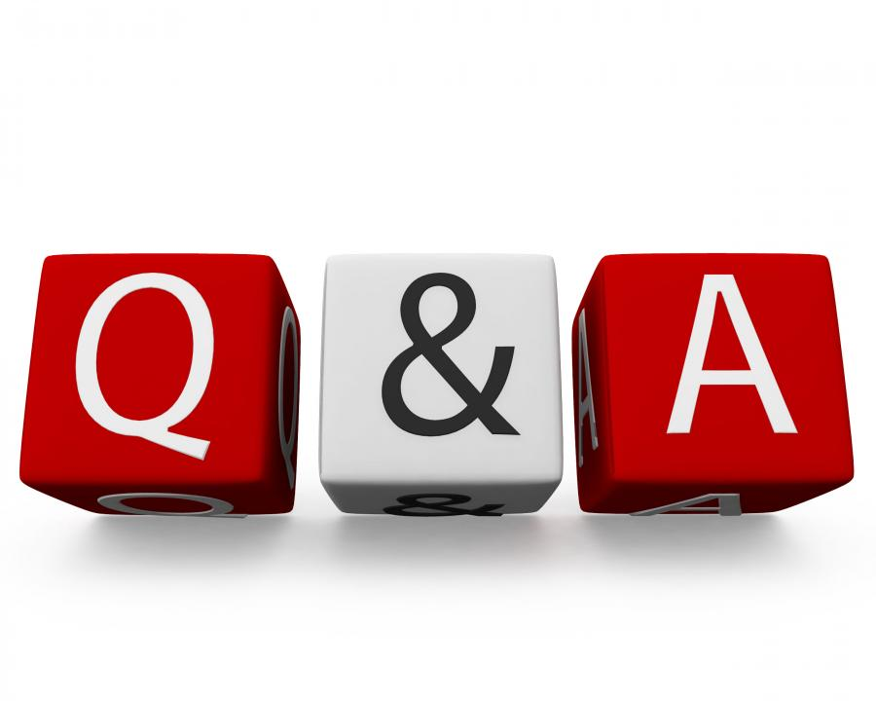
Queries ?

Slide 51


